Slide 1
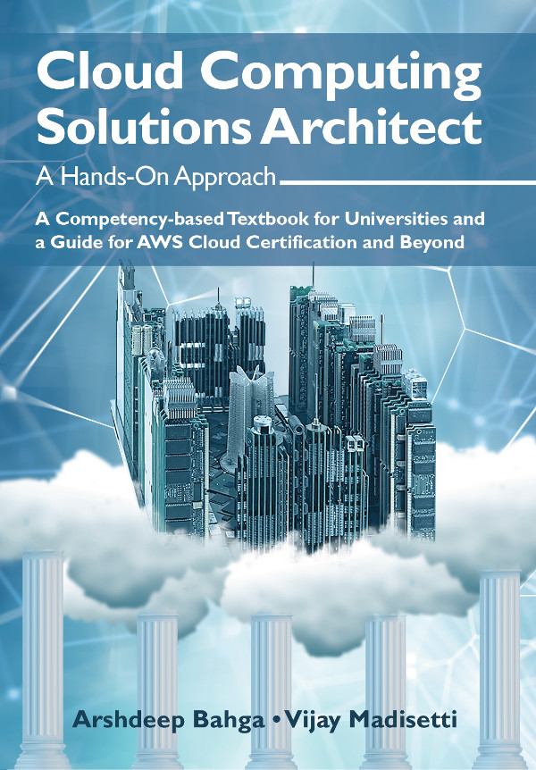
Cloud Application Development

Slide 2
Outline
Design Considerations for Cloud Applications
Reference Architectures and Cloud Component Model
Python Web Application Framework - Django
Case Studies

Slide 3
Design Considerations for Cloud Applications
Scalability
Scalability is an important factor that drives the application designers to move to cloud computing environments. Building applications that can serve millions of users without taking a hit on their performance has always been challenging. With the growth of cloud computing application designers can provision adequate resources to meet their workload levels.
Reliability & Availability
Reliability of a system is defined as the probability that a system will perform the intended functions under stated conditions for a specified amount of time. Availability is the probability that a system will perform a specified function under given conditions at a prescribed time.
Security
Security is an important design consideration for cloud applications given the outsourced nature of cloud computing environments.
Maintenance
To achieve a rapid time-to-market, businesses typically launch their applications with a core set of features ready and then incrementally add new features as and when they are complete. In such scenarios, it is important to design applications with low maintenance and upgradation costs.
Performance
Applications should be designed while keeping the performance requirements in mind.

Slide 4
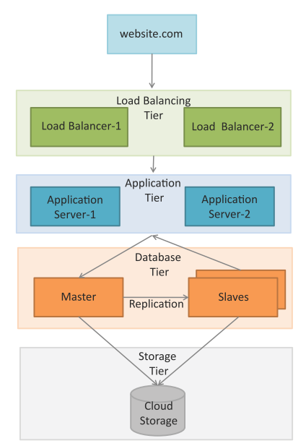
Reference Architectures – e-Commerce, Business-to-Business, Banking and Financial apps
Load Balancing Tier
Load balancing tier consists of one or more load balancers.
Application Tier
For this tier, it is recommended to configure auto scaling.
Auto scaling can be triggered when the recorded values for any of the specified metrics such as CPU usage, memory usage, etc. goes above defined thresholds.
Database Tier
The database tier includes a master database instance and multiple slave instances.
The master node serves all the write requests and the read requests are served from the slave nodes.
This improves the throughput for the database tier since most applications have a higher number of read requests than write requests.

Slide 5
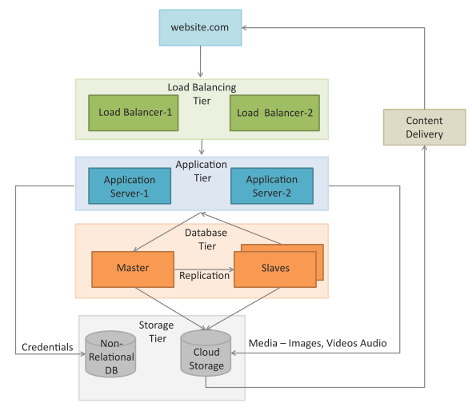
Reference Architectures – Content delivery apps
Figure shows a typical deployment architecture for content delivery applications such as online photo albums, video webcasting, etc.
Both relational and non-relational data stores are shown in this deployment.
A content delivery network (CDN) which consists of a global network of edge locations is used for media delivery.
CDN is used to speed up the delivery of static content such as images and videos.

Slide 6
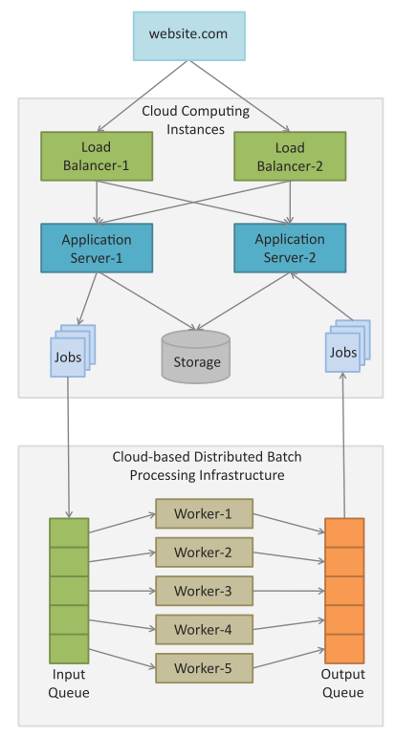
Reference Architectures – Analytics apps
Figure shows a typical deployment architecture for compute intensive applications such as Data Analytics, Media Transcoding, etc.
Comprises of web, application, storage, computing/analytics and database tiers.
The analytics tier consists of cloud-based distributed batch processing frameworks such as Hadoop which are suitable for analyzing big data.
Data analysis jobs (such as MapReduce) jobs are submitted to the analytics tier from the application servers.
The jobs are queued for execution and upon completion the analyzed data is presented from the application servers.

Slide 7
Cloud Component Model
Cloud Component Model is an application design methodology that provides a flexible way of creating cloud applications in a rapid, convenient and platform independent manner.
CCM is an architectural approach for cloud applications that is not tied to any specific programming language or cloud platform.
Cloud applications designed with CCM approach can have innovative hybrid deployments in which different components of an application can be deployed on cloud infrastructure and platforms of different cloud vendors.
Applications designed using CCM have better portability and interoperability.
CCM based applications have better scalability by decoupling application components and providing asynchronous communication mechanisms.

Slide 8
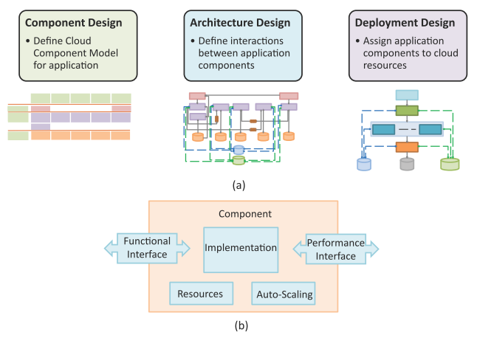
CCM Application Design Methodology
CCM approach for application design involves:
Component Design
Architecture Design
Deployment Design

Slide 9
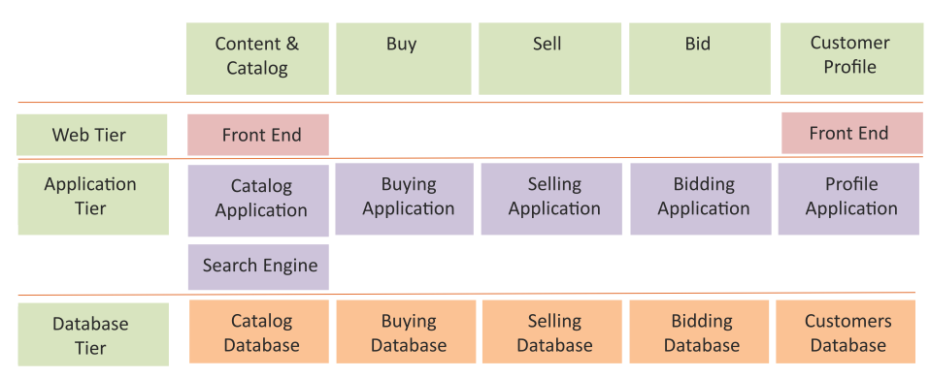
CCM Component Design
Cloud Component Model is created for the application based on comprehensive analysis of the application’s functions and building blocks.
Cloud component model allows identifying the building blocks of a cloud application which are classified based on the functions performed and type of cloud resources required.
Each building block performs a set of actions to produce the desired outputs for other components.
Each component takes specific inputs, performs a pre-defined set of actions and produces the desired outputs.
Components offer their functions as services through a functional interface which can be used by other components.
Components report their performance to a performance database through a performance interface.
CCM map for an e-Commerce application

Slide 10
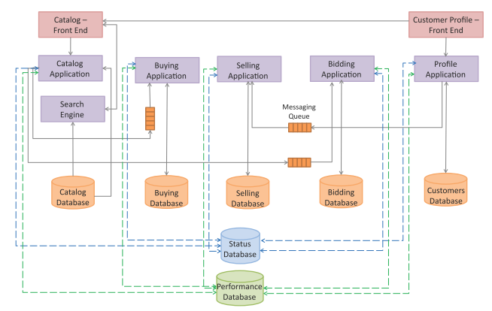
CCM Architecture Design
In Architecture Design step, interactions between the application components are defined.
CCM components have the following characteristics:
Loose Coupling
Components in the Cloud Component Model are loosely coupled.
Asynchronous Communication
By allowing asynchronous communication between components, it is possible to add capacity by adding additional servers when the application load increases. Asynchronous communication is made possible by using messaging queues.
Stateless Design
Components in the Cloud Component Model are stateless. By storing session state outside of the component (e.g. in a database), stateless component design enables distribution and horizontal scaling.
Architecture design of an e-Commerce application.

Slide 11
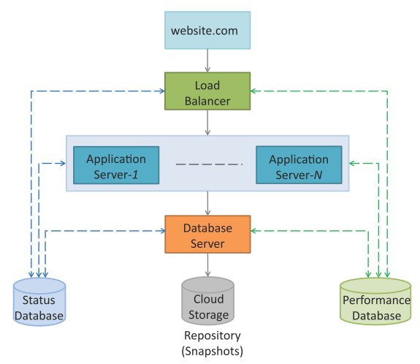
CCM Deployment Design
In Deployment Design step, application components are mapped to specific cloud resources such as web servers, application servers, database servers, etc.
Since the application components are designed to be loosely coupled and stateless with asynchronous communication, components can be deployed independently of each other.
This approach makes it easy to migrate application components from one cloud to the other.
With this flexibility in application design and deployment, the application developers can ensure that the applications meet the performance and cost requirements with changing contexts.
Deployment design of an e-Commerce application

Slide 12
Python Web Application Framework – Django https://www.djangoproject.com/
Django is an open source web application framework for developing web applications in Python.
A web application framework in general is a collection of solutions, packages and best practices that allows development of web applications and dynamic websites.
Django is based on the Model-Template-View architecture and provides a separation of the data model from the business rules and the user interface.
Django provides a unified API to a database backend.
Thus web applications built with Django can work with different databases without requiring any code changes.
With this flexibility in web application design combined with the powerful capabilities of the Python language and the Python ecosystem, Django is best suited for cloud applications.
Django consists of an object-relational mapper, a web template system and a regular-expression-based URL dispatcher.

Slide 13
Case studies
Image processing app
Cloud drive app
Social media analytics app

Slide 14
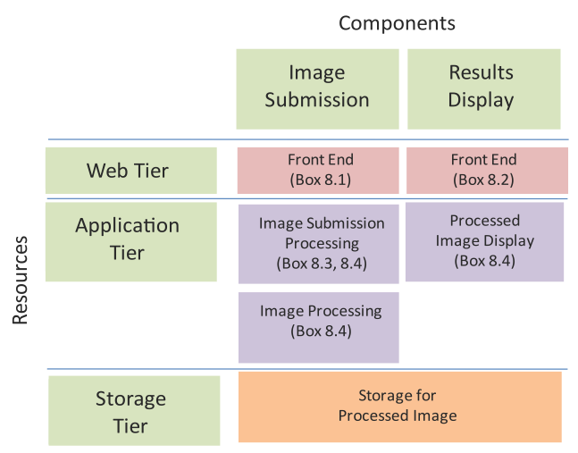
Image Processing App – Component Design
Functionality:
A cloud-based Image Processing application.
This application provides online image ﬁltering capability.
Users can upload image ﬁles and choose the ﬁlters to apply.
The selected ﬁlters are applied to the image and the processed image can then be downloaded.
Component Design
Web Tier: The web tier for the image processing app has front ends for image submission and displaying processed images.
Application Tier: The application tier has components for processing the image submission requests, processing the submitted image and processing requests for displaying the results.
Storage Tier: The storage tier comprises of the storage for processed images.
Component design for Image Processing App

Slide 15
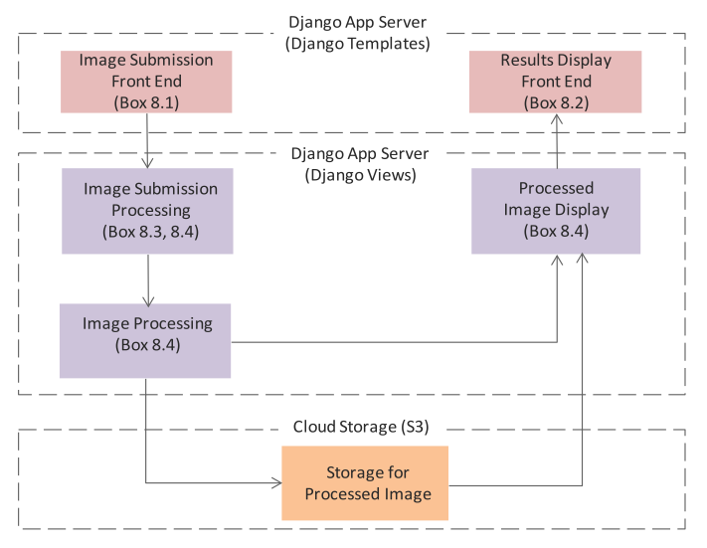
Image Processing App – Architecture Design
Architecture design step which deﬁnes the interactions between the application components.
This application uses the Django framework, therefore, the web tier components map to the Django templates and the application tier components map to the Django views.
A cloud storage is used for the storage tier. For each component, the corresponding code box numbers are mentioned.
Architecture design for Image Processing App

Slide 16
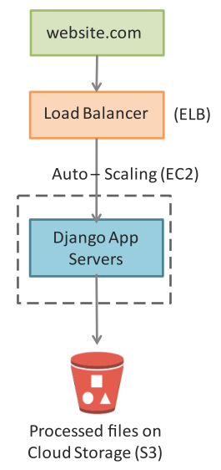
Image Processing App – Deployment Design
Deployment for the app is a multi-tier architecture comprising of load balancer, application servers and a cloud storage for processed images.
For each resource in the deployment the corresponding Amazon Web Services (AWS) cloud service is mentioned.
Deployment design for Image Processing App

Slide 17
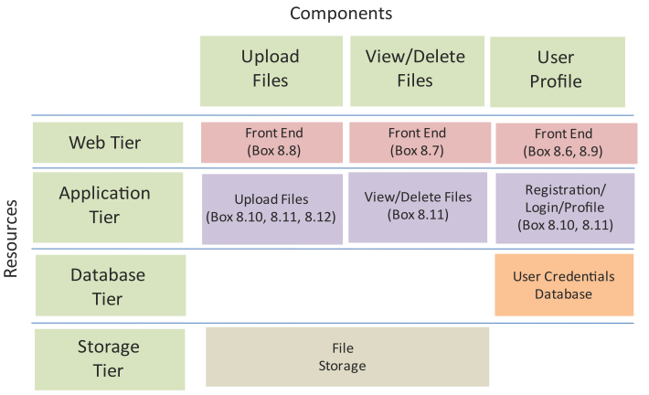
Cloud Drive App – Component Design
Functionality:
A cloud-based document storage (Cloud Drive) application.
This application allows users to store documents on a cloud-based storage.
Component Design
Web Tier: The web tier for the Cloud Drive app has front ends for uploading ﬁles, viewing/deleting ﬁles and user proﬁle.
Application Tier: The application tier has components for processing requests for uploading ﬁles, processing requests for viewing/deleting ﬁles and the component that handles the registration, proﬁle and login functions.
Database Tier: The database tier comprises of a user credentials database.
Storage Tier: The storage tier comprises of the storage for ﬁles.
Component design for Cloud Drive App

Slide 18
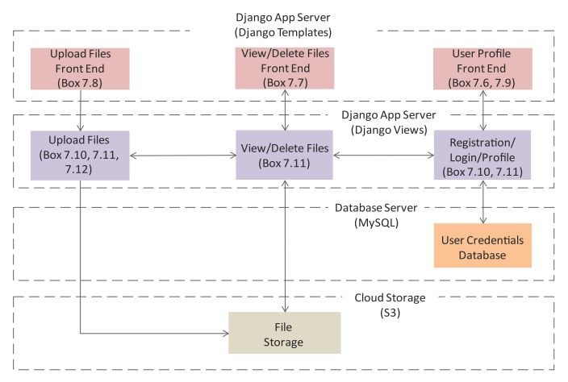
Cloud Drive App – Architecture Design
Architecture design step which deﬁnes the interactions between the application components.
This application uses the Django framework, therefore, the web tier components map to the Django templates and the application tier components map to the Django views.
A MySQL database is used for the database tier and a cloud storage is used for the storage tier.
For each component, the corresponding code box numbers are mentioned.
Architecture design for Cloud Drive App

Slide 19
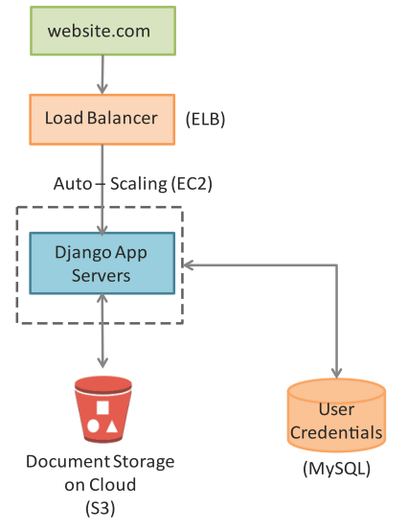
Cloud Drive App – Deployment Design
Deployment for the app is a multi-tier architecture comprising of load balancer, application servers, cloud storage for storing documents and a database server for storing user credentials.
For each resource in the reference architecture the corresponding Amazon Web Services (AWS) cloud service is mentioned.
Deployment design for Cloud Drive App

Slide 20
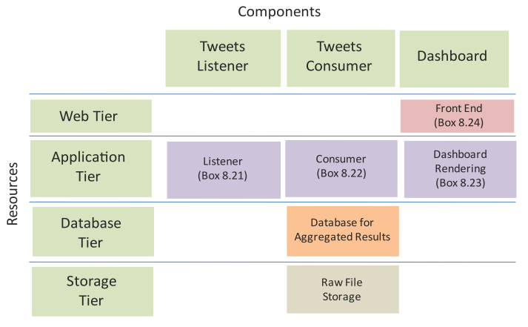
Social Media Analytics App – Component Design
Functionality:
A cloud-based Social Media Analytics application.
This application collects the social media feeds (Twitter tweets) on a speciﬁed keyword in real time and analyzes the sentiments of the tweets and provides aggregate results.
Component Design
Web Tier: The web tier has a front end for displaying results.
Application Tier: The application tier has a listener component that collects social media feeds, a consumer component that analyzes tweets and a component for rendering the results in the dashboard.
Database Tier: A MongoDB database is used for the database tier and a cloud storage is used for the storage tier.
Storage Tier: The storage tier comprises of the storage for ﬁles.
Component design for Social Media Analytics App

Slide 21
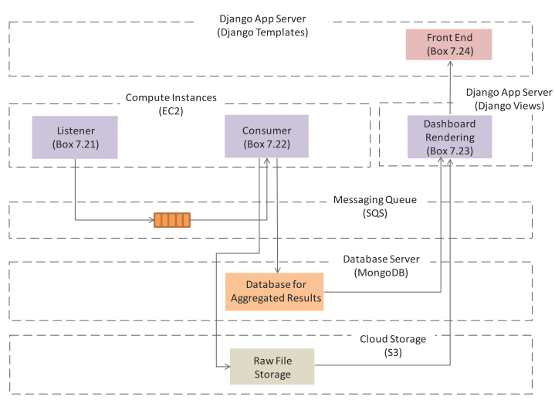
Social Media Analytics App – Architecture Design
Architecture design step which deﬁnes the interactions between the application components.
To make the application scalable the feeds collection component (Listener) and feeds processing component (Consumer) are separated.
The Listener component uses the Twitter API to get feeds on a speciﬁc keyword (or a list of keywords) and enqueues the feeds to a queue.
The Consumer component (that runs on a separate instance) retrieves the feeds from the queue and analyzes the feeds and stores the aggregated results in a separate database.
The aggregate results are displayed to the users from a Django application.
Architecture design for Social Media Analytics App

Slide 22
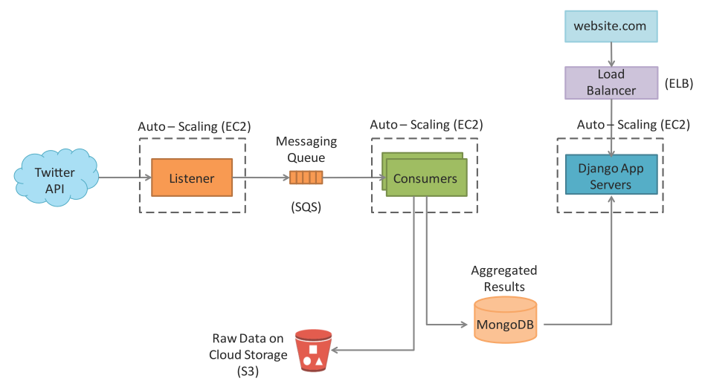
Social Media Analytics App – Deployment Design
Deployment for the app is a multi-tier architecture comprising of load balancer, application servers, listener and consumer instances, a cloud storage for storing raw data and a database server for storing aggregated results.
For each resource in the deployment the corresponding Amazon Web Services (AWS) cloud service is mentioned.
Deployment design for Social Media Analytics App

Slide 23
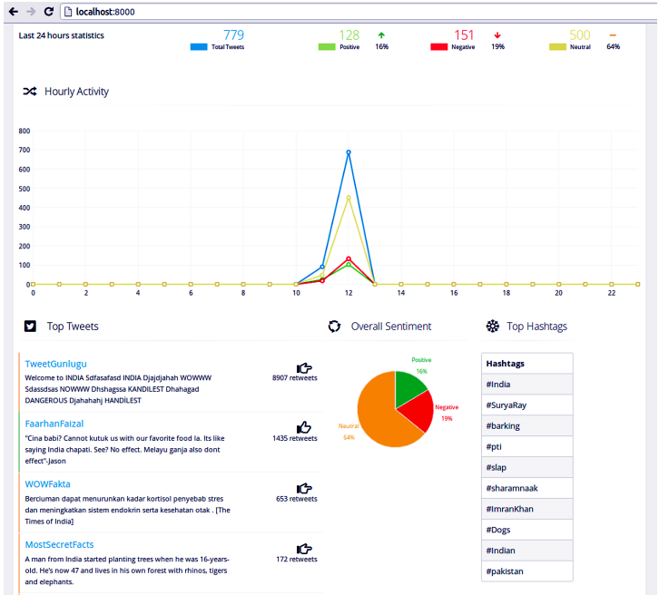
Social Media Analytics App – Dashboard

